Slide 1
Data Structures and Algorithms -3 (25CS2103E)
Travelling Salesman Route Planner using Bitmask Dynamic Programming
Team Members
A.Kuvira 2520030192
K.Rishita 2520030367
P.Sudha 2520030455
Under the Esteemed Guidance of
Name of the DSA-3 faculty name with designation and department

Slide 2
Contents
Abstract
Introduction
Literature survey
Problem Statement and Objectives
Hardware and Software requirements
Results
Conclusion
Future Scope

Slide 3
Abstract
Travelling Salesman Problem (TSP) is a classic combinatorial optimization problem for finding the minimum-cost route through all cities.
The project uses Bitmask Dynamic Programming to efficiently solve TSP.
Bitmasks represent the set of cities that have already been visited.
Dynamic Programming stores previously calculated results to avoid repeated computations.
The system calculates the minimum travel cost and identifies the optimal route.
The generated route is displayed through route visualization for easy understanding.
The project compares Bitmask DP with naïve/brute-force approaches in terms of efficiency.
It demonstrates the practical application of Dynamic Programming in combinatorial optimization and route planning.

Slide 4
Introduction
The Travelling Salesman Problem (TSP) is a classic combinatorial optimization problem.
It aims to find the shortest or minimum-cost route that visits every city exactly once and returns to the starting city.
The number of possible routes increases rapidly as the number of cities grows.
Brute-force methods require checking a large number of possible routes, making them inefficient for larger inputs.
Bitmask Dynamic Programming provides an efficient approach by representing visited cities using binary masks.
Previously computed results are stored and reused to reduce repeated calculations.
The project develops a route planning application that calculates the optimal route and minimum travel cost.
The solution is also visualized as a graph, making the route easier to understand.
The project demonstrates the practical use of Dynamic Programming and graph-based optimization.

Slide 5
Literature Survey
Dantzig, Fulkerson and Johnson (1954): Introduced an important mathematical approach for solving the Travelling Salesman Problem using integer programming and cutting-plane techniques.
Held and Karp (1962): Proposed a Dynamic Programming approach for TSP, forming the foundation for modern subset-based DP solutions.
Bellman (1962): Developed the Dynamic Programming formulation for routing problems and demonstrated how complex optimization problems can be divided into smaller subproblems.
Lawler et al. (1985): Presented comprehensive methods for solving TSP, including Dynamic Programming, branch-and-bound, and approximation techniques.
Recent TSP research: Modern approaches increasingly combine exact algorithms, heuristics, metaheuristics, and machine learning to handle large-scale routing problems.
Research Gap: Traditional exact methods provide optimal solutions but become computationally expensive as the number of cities increases. This project focuses on Bitmask Dynamic Programming for efficiently solving small-to-medium-sized TSP instances while providing optimal path visualization and performance comparison.

Slide 6
Problem Statement and Objectives
The Travelling Salesman Problem (TSP) requires finding a minimum-cost route that visits every city exactly once and returns to the starting city.
As the number of cities increases, the number of possible routes grows rapidly.
Naïve brute-force approaches become computationally expensive for larger inputs.
An efficient optimization technique is required to solve TSP while reducing repeated calculations.
To implement Bitmask Dynamic Programming for solving TSP.
To determine the minimum-cost route visiting all cities exactly once.
To calculate and display the total minimum travel cost.

Slide 7
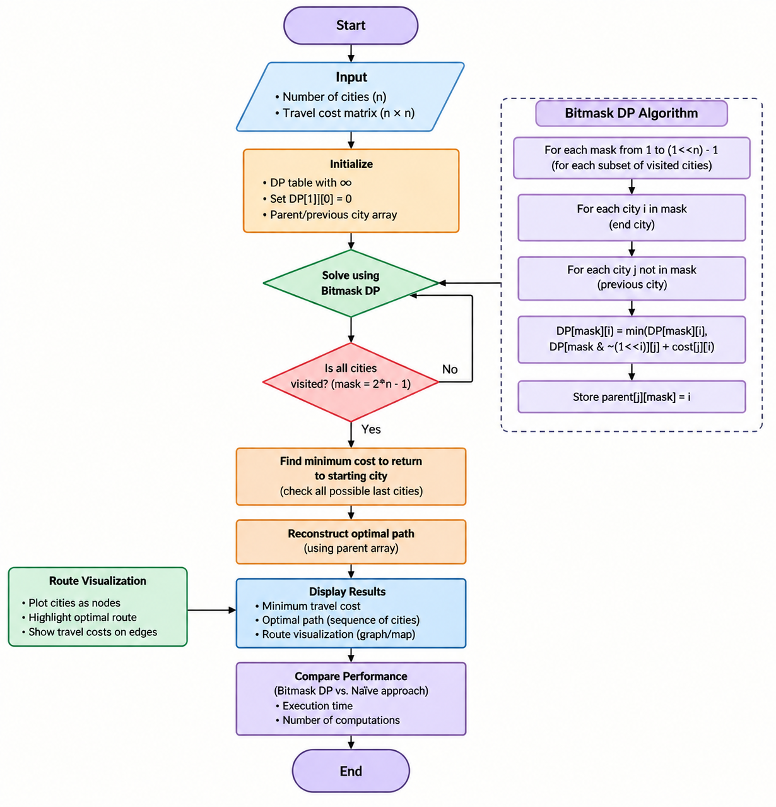
Flow Chart

Slide 8
Results
Successfully implemented TSP using Bitmask Dynamic Programming.
Calculated the minimum-cost route for the given cities and travel costs.
Generated the optimal path and total travel cost.
Visualized the selected route using a graph-based representation.
Reduced repeated computations compared with the naïve brute-force approach.
Demonstrated the practical use of Dynamic Programming for combinatorial optimization.

Slide 9
Hardware and Software requirements
Hardware:
Processor: Intel Core i3 or equivalent and above
RAM: Minimum 4 GB
Storage: Minimum 500 MB free space
Display: Standard monitor
Keyboard and Mouse: Standard input devices
Software:
Operating System: Windows / Linux / macOS
Programming Language: Java / Python
IDE: VS Code / IntelliJ IDEA
Frontend: HTML, CSS, JavaScript
Visualization: D3.js / Chart.js
Browser: Google Chrome / Microsoft Edge
Version Control: Git and GitHub

Slide 10
Conclusion
The project successfully demonstrates an efficient solution to the Travelling Salesman Problem using Bitmask Dynamic Programming.
The algorithm calculates the minimum travel cost while generating the corresponding optimal route.
Bitmask representation efficiently manages the visited-city states.
Compared with brute-force methods, Dynamic Programming avoids repeated calculations and improves efficiency.
Route visualization makes the solution easy to understand and interpret.
The project demonstrates the practical application of Dynamic Programming, graph algorithms, and combinatorial optimization.

Slide 11
Future Scope
Support larger numbers of cities using more advanced optimization techniques.
Add real-world map integration with GPS and location data.
Use real-time distance and traffic information for route planning.
Implement additional algorithms such as Genetic Algorithm, Simulated Annealing, or Branch and Bound.
Add interactive route editing and city management.
Develop a mobile or web-based version for practical use.
Extend the system to support multiple vehicles and delivery routes.

Slide 12
Thank you

